Slide 1
Foundations of Data Science & Analytics (DSCI 633, Fall 2022)
Nidhi Rastogi
Assistant Professor, GCCIS
Rochester Institute of Technology
August 25, 2022

Slide 2
Instructor Introduction
Ph.D. in Computer Science, Rensselaer Polytechnic Institute
M.S. in Computer Science, University of Cincinnati
B.I.T. , Delhi University, India
Worked at GE Global Research, Verizon
Interned at Yahoo, IBM Zurich, BBN Raytheon
Research Interests - Machine learning, Graphs, Security, Autonomous Vehicles, Large distributed networks…

Slide 3

TA Introduction
Addl Tariq
MS Data Science, 2nd Year
TA Hours, email on class GitHub webpage
Also available outside of office hours
Only by appointment – contact on slack or email

Slide 4
Course Information
GitHub link - https://github.com/aiforsec/RIT-DSCI-633-FDS

Slide 5

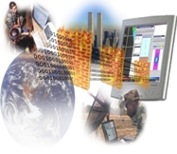
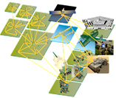

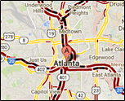



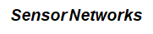
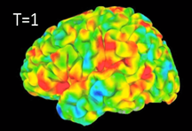
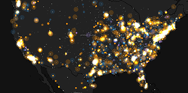
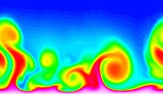
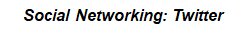
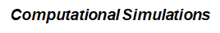
Data Mining is Everywhere
Brain Activity

Slide 6


Behind the Trend (Why?)
Lots of data is being collected and warehoused
Yahoo has Peta Bytes of web data
Facebook has billions of monthly active users
Amazon handles millions of visits/day
Computation has become cheaper and more powerful

Slide 7
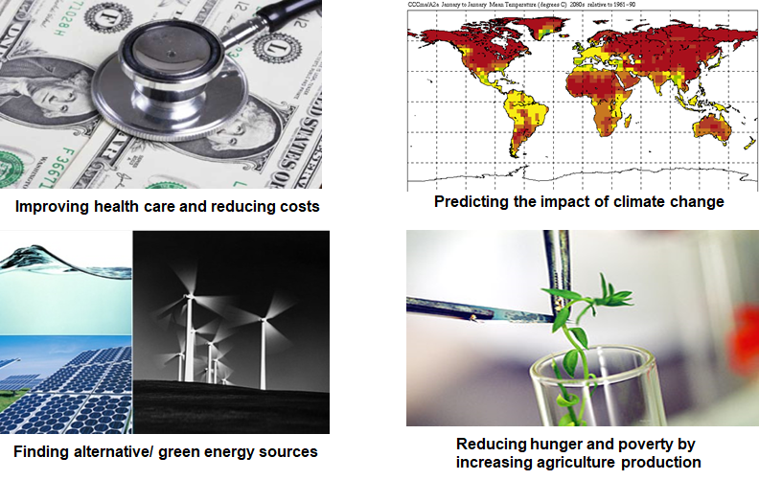

Great Opportunity
Optimizing the development of software

Slide 8
What is NOT Data Mining?
Look up phone number in phone directory
Query a Web search engine for information about “Amazon”
What is Data Mining?
Certain names are more prevalent in certain US locations (O’Brien, O’Rourke, O’Reilly… in Boston area)
Predict whether user want information on Amazon rainforest or Amazon.com when searching for “Amazon”

Slide 9
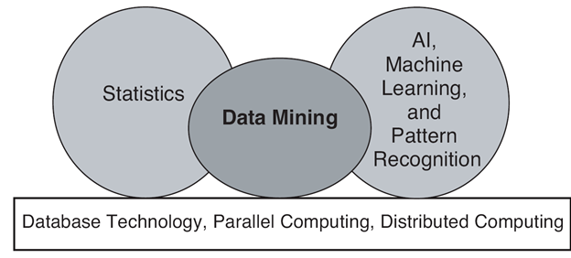
Origin of Data Mining
Especially for data:
Large-scale
High dimensional
Complex
Distributed

Slide 10
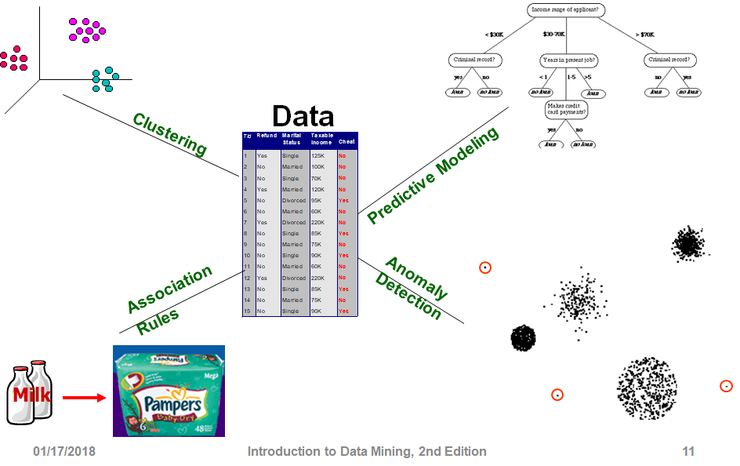
Tasks

Slide 11
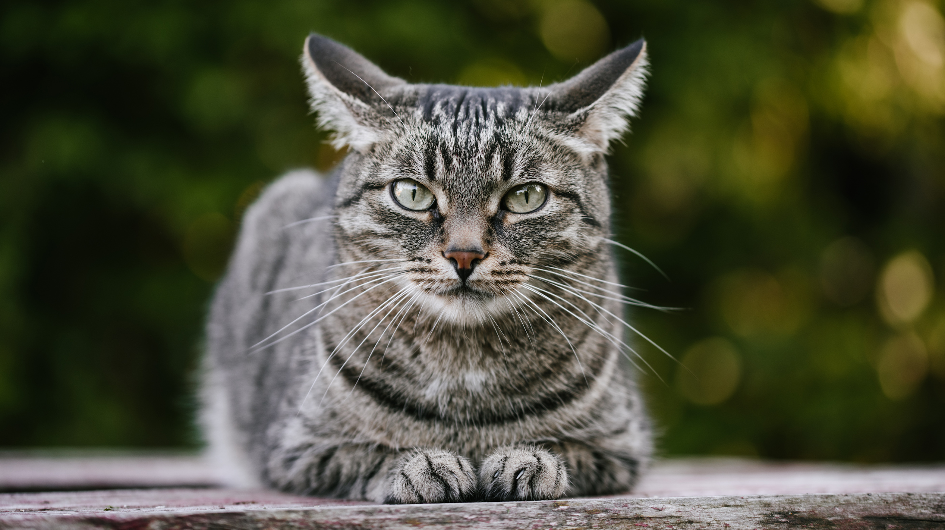
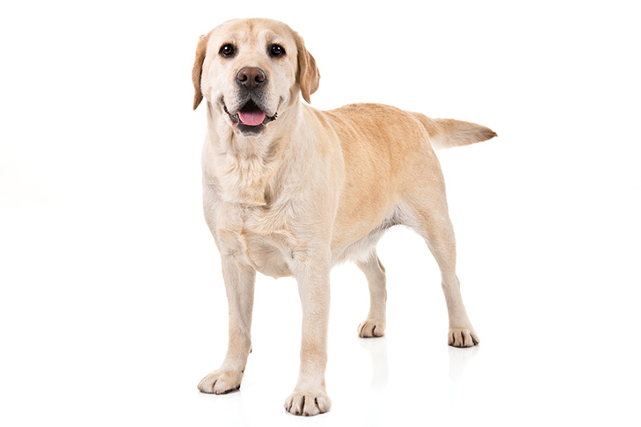
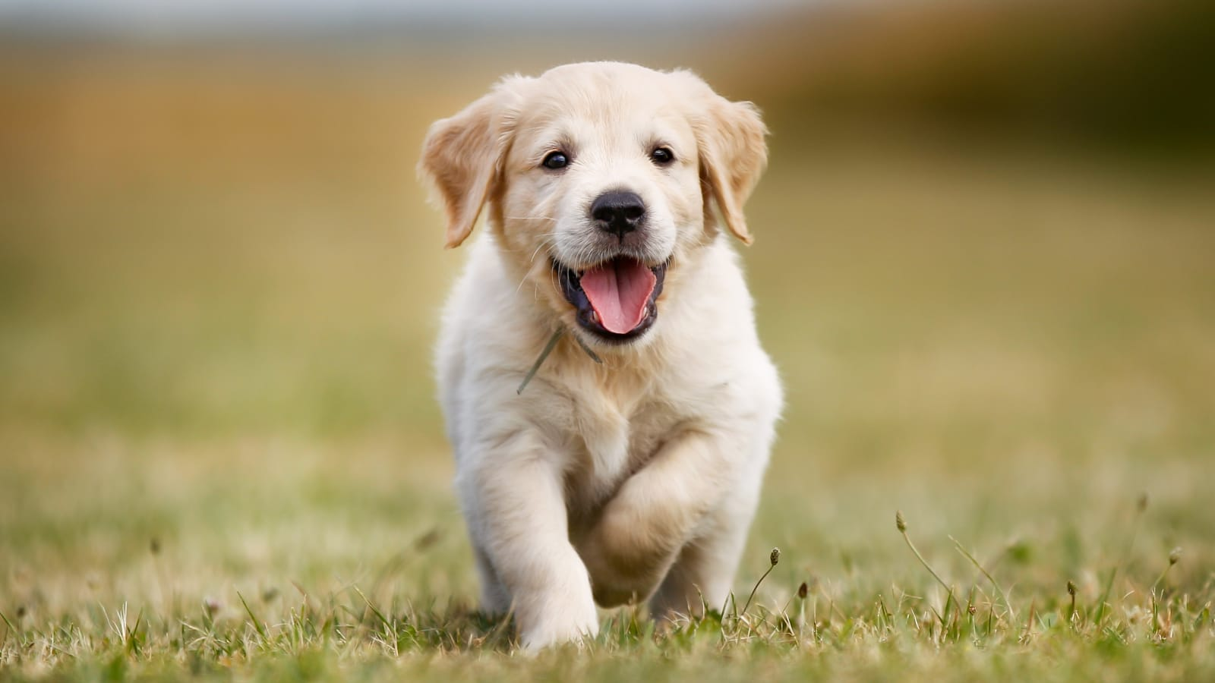
Predictive Modeling (supervised learning)
Independent Variable (Input)
Dependent Variable (Output)
Cat
Train:
Dog
Predict:
?

Slide 12
Predictive Modeling
Output
Classification:
Regression:
Classes / Categories
Continuous Numbers

Slide 13
Predictive Modeling: Classification
Image Classification
Cat
Dog
Bird
Pig
Lion
...

Slide 14
Predictive Modeling: Classification
Sentiment Analysis (NLP)
You have been working on this for months.
I need to see your results, now!
Positive
Neutral
Negative

Slide 15
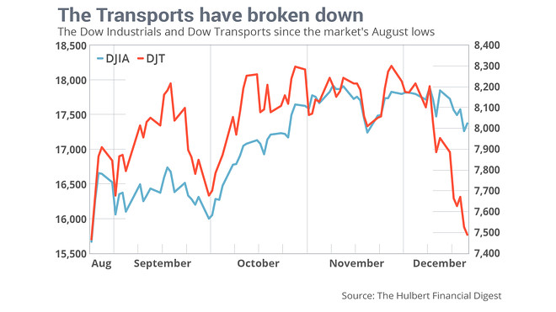
Predictive Modeling: Regression
Time Series Analysis
DJIA and DJT for January?

Slide 16
Predictive Modeling: Regression
ID | Name | Gender | GRE | Coding
001 | Emily Wang | F | 320 | Yes
002 | James Bond | M | 320 | Yes
Problem?
Bias
Score in Foundation of Data Science

Slide 17
Tasks

Slide 18
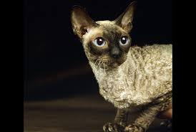
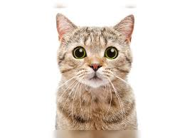
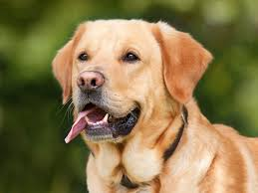
Clustering (unsupervised learning)
Independent Variable

Slide 19
Clustering (unsupervised learning)
Independent Variable

Slide 20
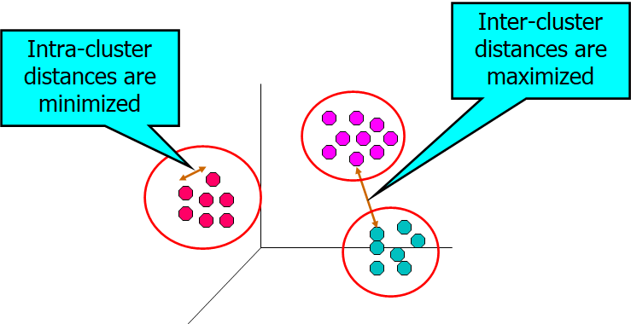
Clustering (objectives)

Slide 21
Clustering (applications)
User ID | Titanic | Die Hard | Avatar
001 | Yes | Yes | No
002 | Yes | No | Yes
Groups of users that like similar movies

Slide 22
Clustering (applications)
Topic Modeling
Area soccer players earn all-state selections.
Sports | Politics | News | Movie
0.4 | 0.18 | 0.4 | 0.02

Slide 23
Tasks

Slide 24
Association Rule Learning
User ID | Titanic | Die Hard | Avatar
001 | Yes | Yes | Yes
002 | Yes | No | Yes
People who watched Titanic will also watch Avatar

Slide 25
Tasks

Slide 26
Anomaly Detection
Purchase | 11/03/2019 | 11/13/2019 | 11/23/2019 | 12/03/2019 | 12/04/2019
001 | Titanic | Avatar | Die Hard | Aliens | Hunter X Hunter

Slide 27
Tasks
Credit card fraud detection
Co-fail test cases
Weather forecast
Community detection on social networks

Slide 28
Preparation for Assignment and Project
Create GitHub account
Star : https://github.com/aiforsec/RIT-DSCI-633-FDS
4. Slack Channel for the course

Slide 29
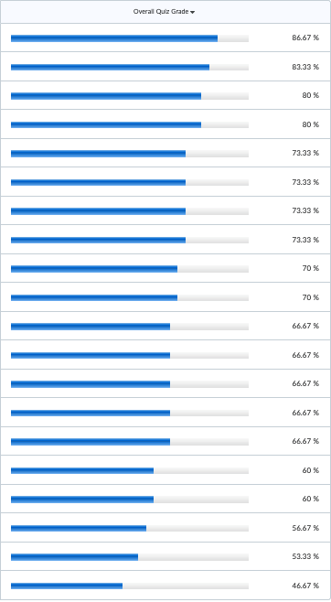
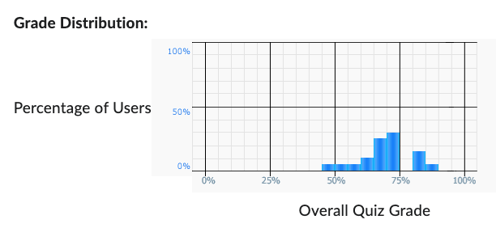
Python Quiz – Class Performance
Class Average: 68.67%

Slide 30
Questions

